Slide 1




NEXT GEN EMPLOYABILITY PROGRAM
Creating a future-ready workforce
Team Members
Arunachala College Of Engineering For Women
Student Name : Jeba Sorna S
Student ID : au960221243026

Slide 2

CAPSTONE PROJECT SHOWCASE
Project Title
Car Rentals Application with Django Framework
Abstract | Problem Statement | Project Overview | Proposed Solution | Technology Used | Modelling & Results | Conclusion

Slide 3
Abstract
Car rental systems play a pivotal role in modern transportation infrastructure, offering convenient access to vehicles for diverse purposes ranging from daily commutes to leisure travel. This abstract explores strategies to enhance the efficiency and user experience of car rental systems.
Firstly, the abstract examines the integration of advanced technologies such as GPS tracking, IoT sensors, and mobile applications to streamline the booking process, improve fleet management, and enhance vehicle tracking capabilities. Leveraging these technologies enables real-time monitoring of vehicle availability, location, and condition, thereby optimizing fleet utilization and reducing administrative overhead.
Overall, this abstract underscores the importance of adopting a holistic approach to enhance the efficiency and user experience of car rental systems. By integrating advanced technologies, prioritizing user-centric design, embracing sustainability, and leveraging data-driven insights, car rental companies can stay competitive in an increasingly dynamic and interconnected transportation landscape.

Slide 4
Problem Statement
Overall, this abstract underscores the importance of adopting a holistic approach to enhance the efficiency and user experience of car rental systems. By integrating advanced technologies, prioritizing user-centric design, embracing sustainability, and leveraging data-driven insights, car rental companies can stay competitive in an increasingly dynamic and interconnected transportation landscape.
Poor Vehicle Tracking and Monitoring: Inadequate vehicle tracking and monitoring systems make it challenging for car rental companies to accurately locate, track, and manage their vehicles in real-time. This deficiency compromises fleet security, increases the risk of theft or misuse, and undermines customer confidence in the reliability of the rental service.
Limited Sustainability Initiatives: The car rental industry faces growing pressure to adopt sustainable practices and reduce environmental impact. However, many car rental companies lag behind in implementing eco-friendly initiatives such as offering electric or hybrid vehicles,

Slide 5
Project Overview
Upgrade Technology Infrastructure:
Implement modern technologies such as cloud computing, mobile applications, and IoT sensors to streamline operations and enhance the overall functionality of the car rental system.
Enhance User Experience:
Develop user-friendly interfaces, intuitive booking platforms, and personalized services to improve customer satisfaction and loyalty.
Optimize Fleet Management:
Utilize data analytics and GPS tracking to optimize fleet utilization, improve vehicle maintenance scheduling, and reduce idle time.
Promote Sustainability:
Introduce eco-friendly initiatives such as offering electric or hybrid vehicles, promoting car-sharing programs, and reducing carbon emissions throughout the rental process.

Slide 6
Proposed Solution
.
The proposed solution aims to address the challenges faced by traditional car rental systems by introducing a comprehensive SmartCar Rental Management System. This system leverages advanced technologies to streamline operations, enhance user experience, optimize fleet management, and promote sustainability within the car rental industry.
Key Features:
1.User-Friendly Booking Platform:
Intuitive web and mobile interfaces for easy booking and reservation management.
Customizable search filters to quickly find vehicles based on preferences such as model, price, location, and availability.
Secure payment gateway integration for seamless online transactions.
2.Fleet Optimization and Tracking:
GPS tracking and telematics integration to monitor vehicle location, status, and performance in real-time.
Automated alerts for maintenance scheduling, fuel levels, and vehicle condition to ensure fleet reliability and safety.
Dynamic routing algorithms to optimize vehicle distribution and reduce idle time.

Slide 7
Sustainability Initiatives:
Integration of electric and hybrid vehicles into the rental fleet to promote eco-friendly transportation options.
Carbon footprint tracking and offsetting programs to minimize environmental impact.
Incentive schemes for customers who opt for sustainable transportation choices.
Personalized Customer Experience:
Profile-based recommendations and personalized offers based on past rental history and preferences.
24/7 customer support through chatbots, FAQs, and live chat to address inquiries and resolve issues promptly.
Loyalty programs and rewards for repeat customers to foster long-term relationships and enhance customer retention.
Data Analytics and Insights:
Advanced data analytics tools to analyze rental data, identify trends, and forecast demand patterns.
Pricing optimization algorithms to adjust rates dynamically based on factors such as seasonality, demand fluctuations, and competitor pricing.
Predictive maintenance analytics to preemptively address vehicle maintenance issues and minimize downtime.

Slide 8
Implementation Plan:
Requirement Analysis:
Conduct thorough analysis to understand user needs, market trends, and operational challenges.
System Design:
Design the architecture and functionalities of the SmartCar Rental Management System.
Development:
Develop the web and mobile applications, backend infrastructure, and integration modules.
Testing:
Conduct rigorous testing to ensure system reliability, performance, and security.
Deployment:
Roll out the system in phases, starting with pilot testing and gradually expanding to full-scale implementation.
Training and Support: Provide comprehensive training to staff and users on using the system effectively. Offer ongoing support and maintenance services to address any issues or updates.

Slide 9


Technology Used
Front-end
Back-end

Slide 10
Modelling & Results
Data Preprocessing:
Clean the dataset by handling missing values, outliers, and data inconsistencies.
Convert categorical variables into numerical representations using techniques like one-hot encoding.
Split the data into training and testing sets, ensuring temporal consistency to capture seasonality and trends.
Feature Engineering:
Extract relevant features such as day of the week, month, and hour from the rental start/end dates to capture temporal patterns.
Create additional features like rental duration and time since last rental to capture user behavior and preferences.
Incorporate external factors such as weather data, holidays, and events that may influence rental demand.

Slide 11
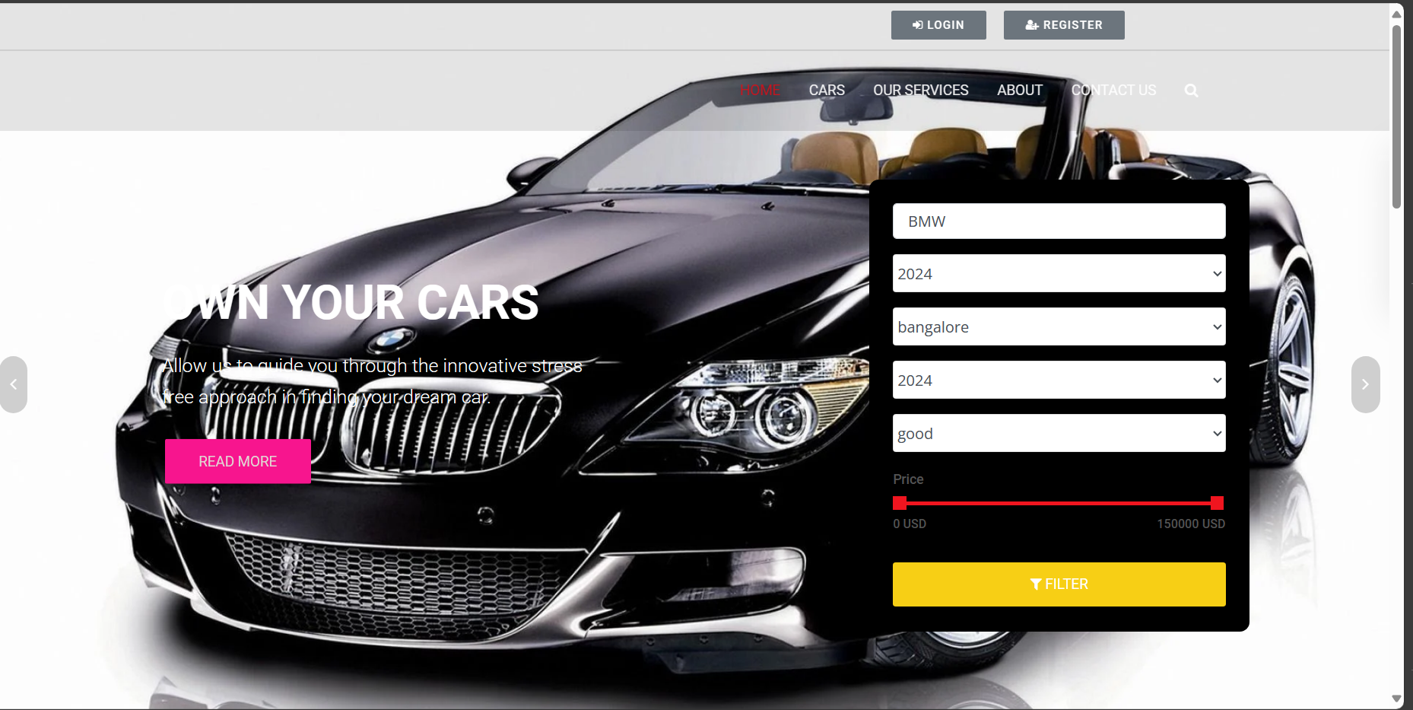
Homepage

Slide 12
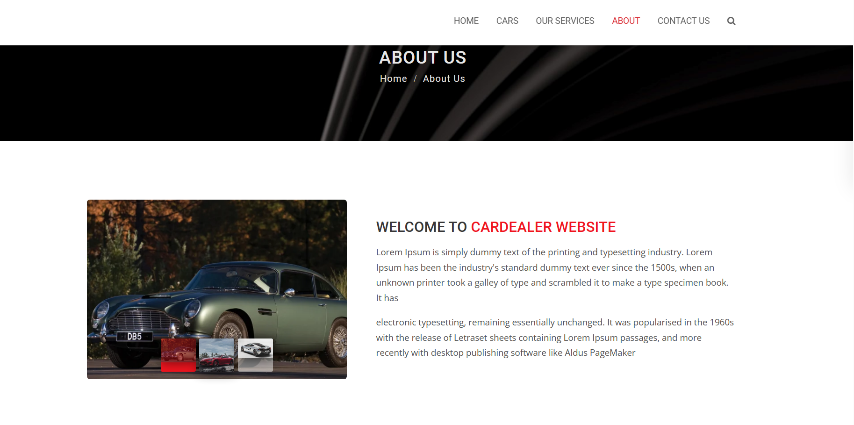
About-Us-Page

Slide 13
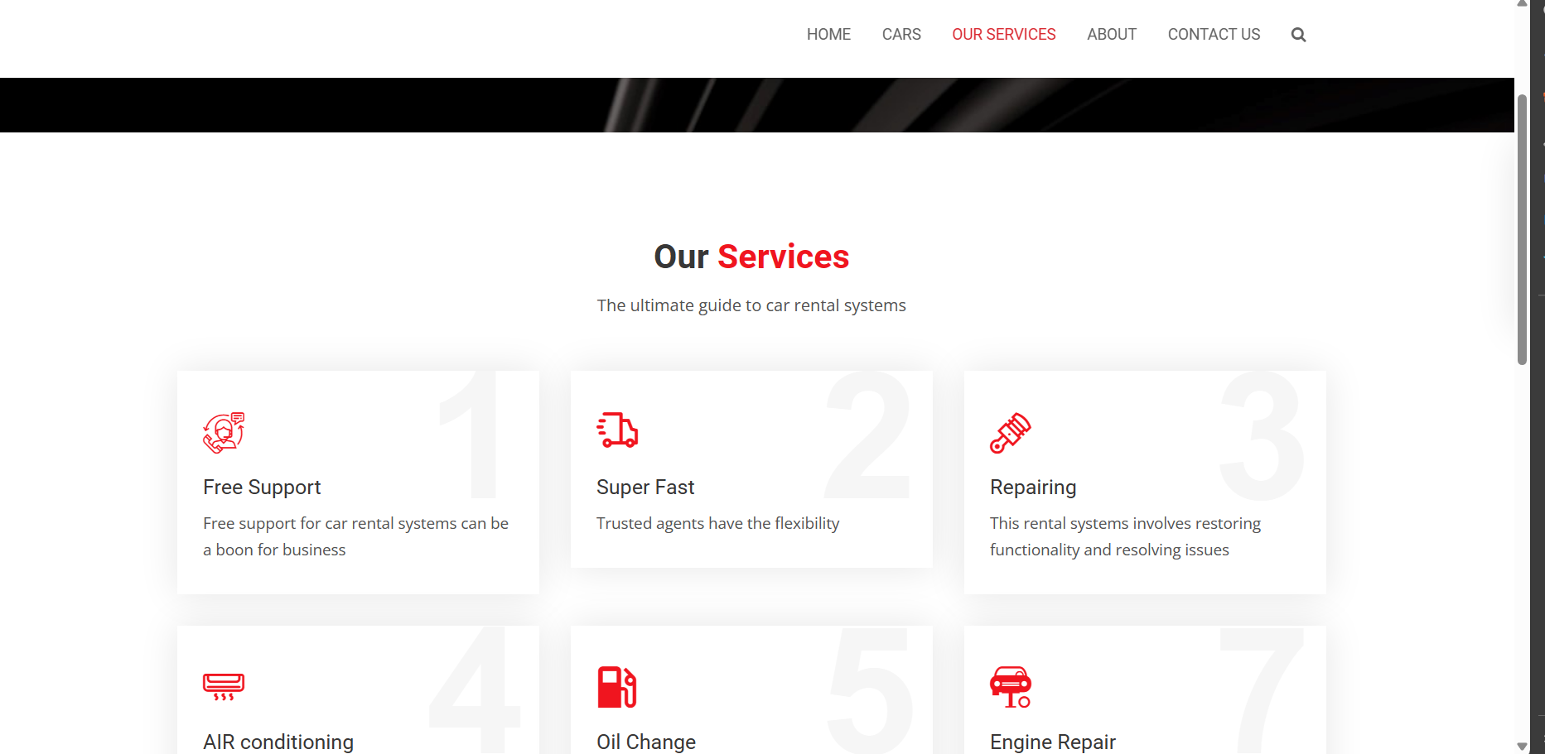
Service-Page

Slide 14
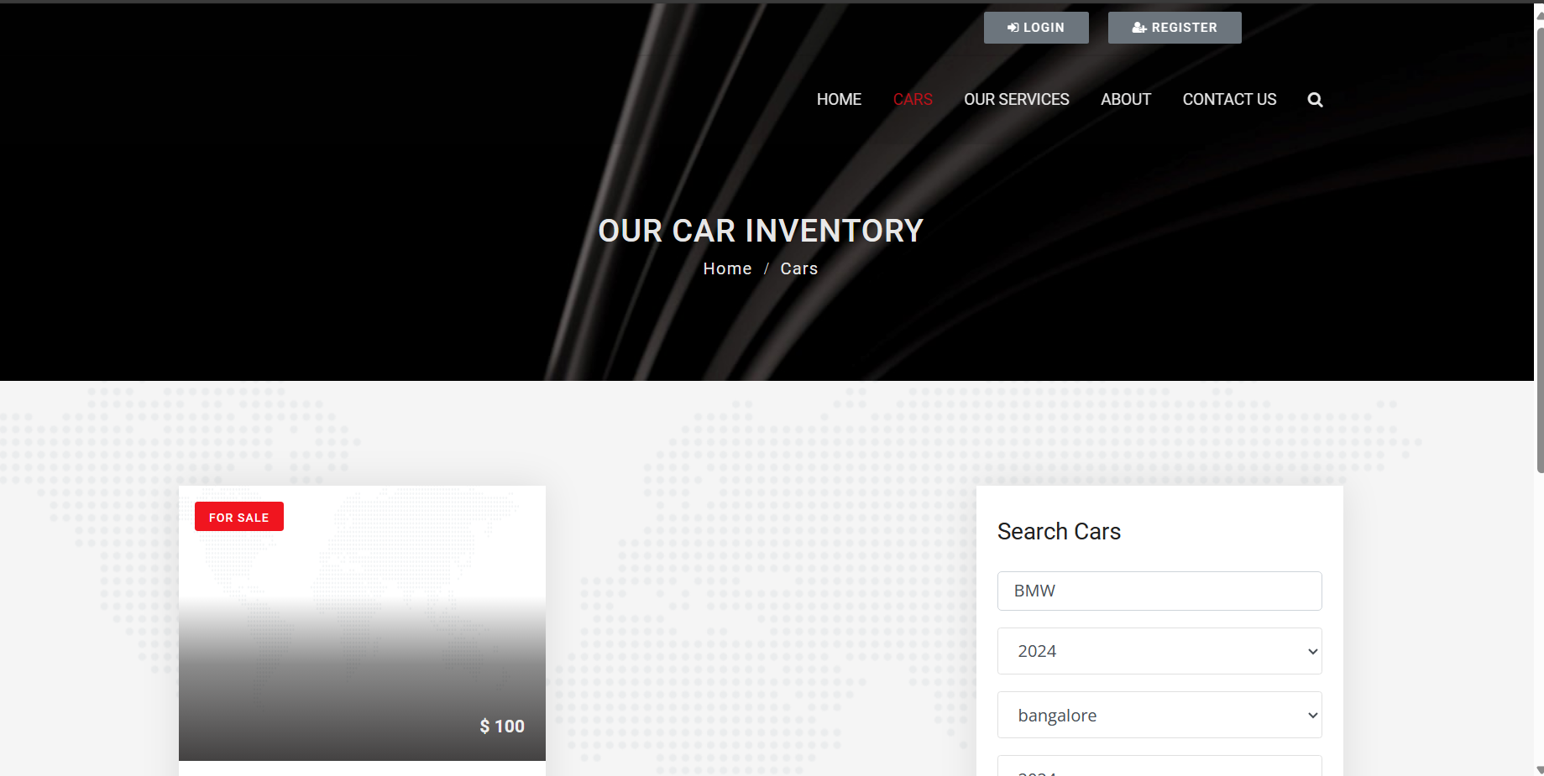
Departments-Page

Slide 15
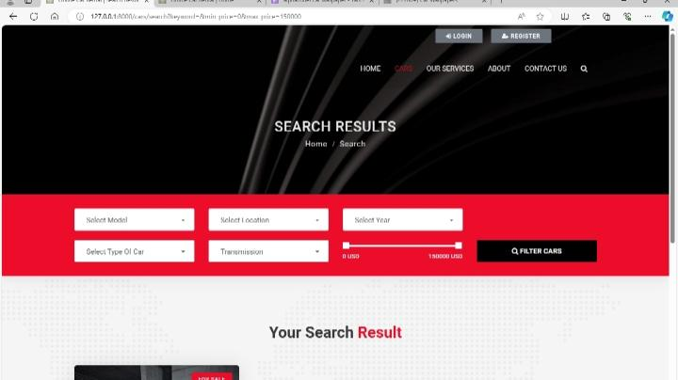
Blog-Page

Slide 16
Future Enhancements:
Integration of Autonomous Vehicles: Explore the integration of autonomous vehicles into the rental fleet to offer innovative transportation solutions. Develop systems for managing autonomous vehicle rentals, including remote monitoring, scheduling, and maintenance.
Blockchain for Security and Transparency: Implement blockchain technology to enhance security and transparency in rental transactions. Utilize blockchain for secure storage of rental agreements, vehicle history records, and payment transactions, ensuring data integrity and fraud prevention.
AI-Powered Customer Service: Develop AI-powered chatbots and virtual assistants to provide personalized customer support and streamline rental inquiries, reservations, and troubleshooting. Incorporate natural language processing (NLP) and machine learning algorithms to improve response accuracy and customer satisfaction.
Enhanced Vehicle Tracking and Telematics: Integrate advanced telematics systems and IoT sensors into rental vehicles for real-time tracking of location, vehicle health, and driver behavior. Utilize predictive maintenance algorithms to proactively address maintenance issues and minimize downtime.

Slide 17
Conclusion
In conclusion, the evolution of car rental systems represents a pivotal transformation in the transportation industry, driven by advancements in technology, shifting consumer preferences, and a growing emphasis on sustainability. Through the implementation of innovative solutions and strategic enhancements, car rental companies have the opportunity to optimize operations, enhance customer experience, and contribute to a more efficient and environmentally conscious mobility ecosystem.
The proposed enhancements, including the integration of autonomous vehicles, adoption of blockchain technology, deployment of AI-powered customer service, and expansion of environmental sustainability initiatives, offer promising avenues for future development. By embracing these advancements, car rental systems can redefine the way people access and utilize transportation services, fostering greater convenience, reliability, and accessibility for users worldwide.

Slide 18
Thank You!
Notes:
Thank You !!

